Slide 1

Power Exchange Together PET: North Central New Jersey
Topic: How You Started and Where Are You Going
In person Meeting:
Date: Saturday, February 15, 2025
Time: 2pm to 4pm
Where: Little Italy Brick Oven Pizza and Café, 459 NJ-31, Washington NJ, 07882

Slide 2
Power Exchange Together PET: North Central New Jersey
Topic: How You Started and Where Are You Going
In person Meeting:
Date: Saturday, February 15, 2025
Time: 2pm to 4pm
Where: Little Italy Brick Oven Pizza and Café, 459 NJ-31, Washington NJ, 07882

Slide 3
Power Exchange Together PET: North Central New Jersey
Topic: The Art of the Scene: Crafting Moments with Intention and Flow
In person Meeting:
Date: Saturday, March 1, 2025
Time: 2pm to 4pm
Where: Little Italy Brick Oven Pizza and Café, 459 NJ-31, Washington NJ, 07882

Slide 4
Power Exchange Together PET: North Central New Jersey
Topic: Go to our group page to vote on April topic.
In person Meeting: RSVP
Date: Saturday, April 5, 2025
Time: 2pm to 4pm
Where: Little Italy Brick Oven Pizza and Café, 459 NJ-31, Washington NJ, 07882

Slide 5
Power Exchange Together PET: North Central New Jersey
Topic: Vote on our group page
NRE vs MRE read description on group page
Motivation: read description on group page
Schedule
2-2:15 Social 2:15-3:00 Group Discussion 3:00-3:45 D group & s group 3:45-4:00 Q&A and That's a wrap.

Slide 6
Power Exchange Together PET: North Central New Jersey
Topic: Negotiation is Sexy
The Art of Consent & Communication
In person Meeting: RSVP
Date: Saturday, May 3, 2025
Time: 2pm to 4pm
Schedule
2-2:15 Social 2:15-3:00 Group Discussion 3:00-3:45 D group & s group 3:45-4:00 Q&A and That's a wrap.

Slide 7
Power Exchange Together PET: North Central New Jersey
Topic: BBQ Social for Vetted Members Only
Must have attended a prior meeting to be invited
In person Meeting: RSVP
Date: Saturday, June 7, 2025
Time: 3pm to 6pm
Location will be sent via e-mail the week of
Schedule
3-6 Social Bring a side dish to share

Slide 8


Slide 9
✨

Slide 10

✨

Slide 11


Slide 14


Stil Kinky
In Xanadu
Podcast

Slide 15

Kinky Ever After

Slide 16


About. Bios House of Xanadu Power Exchange Together Podcast Contact us
Kink Doesn’t Retire
Podcast
Welcome to Xanadu KINK

Slide 17



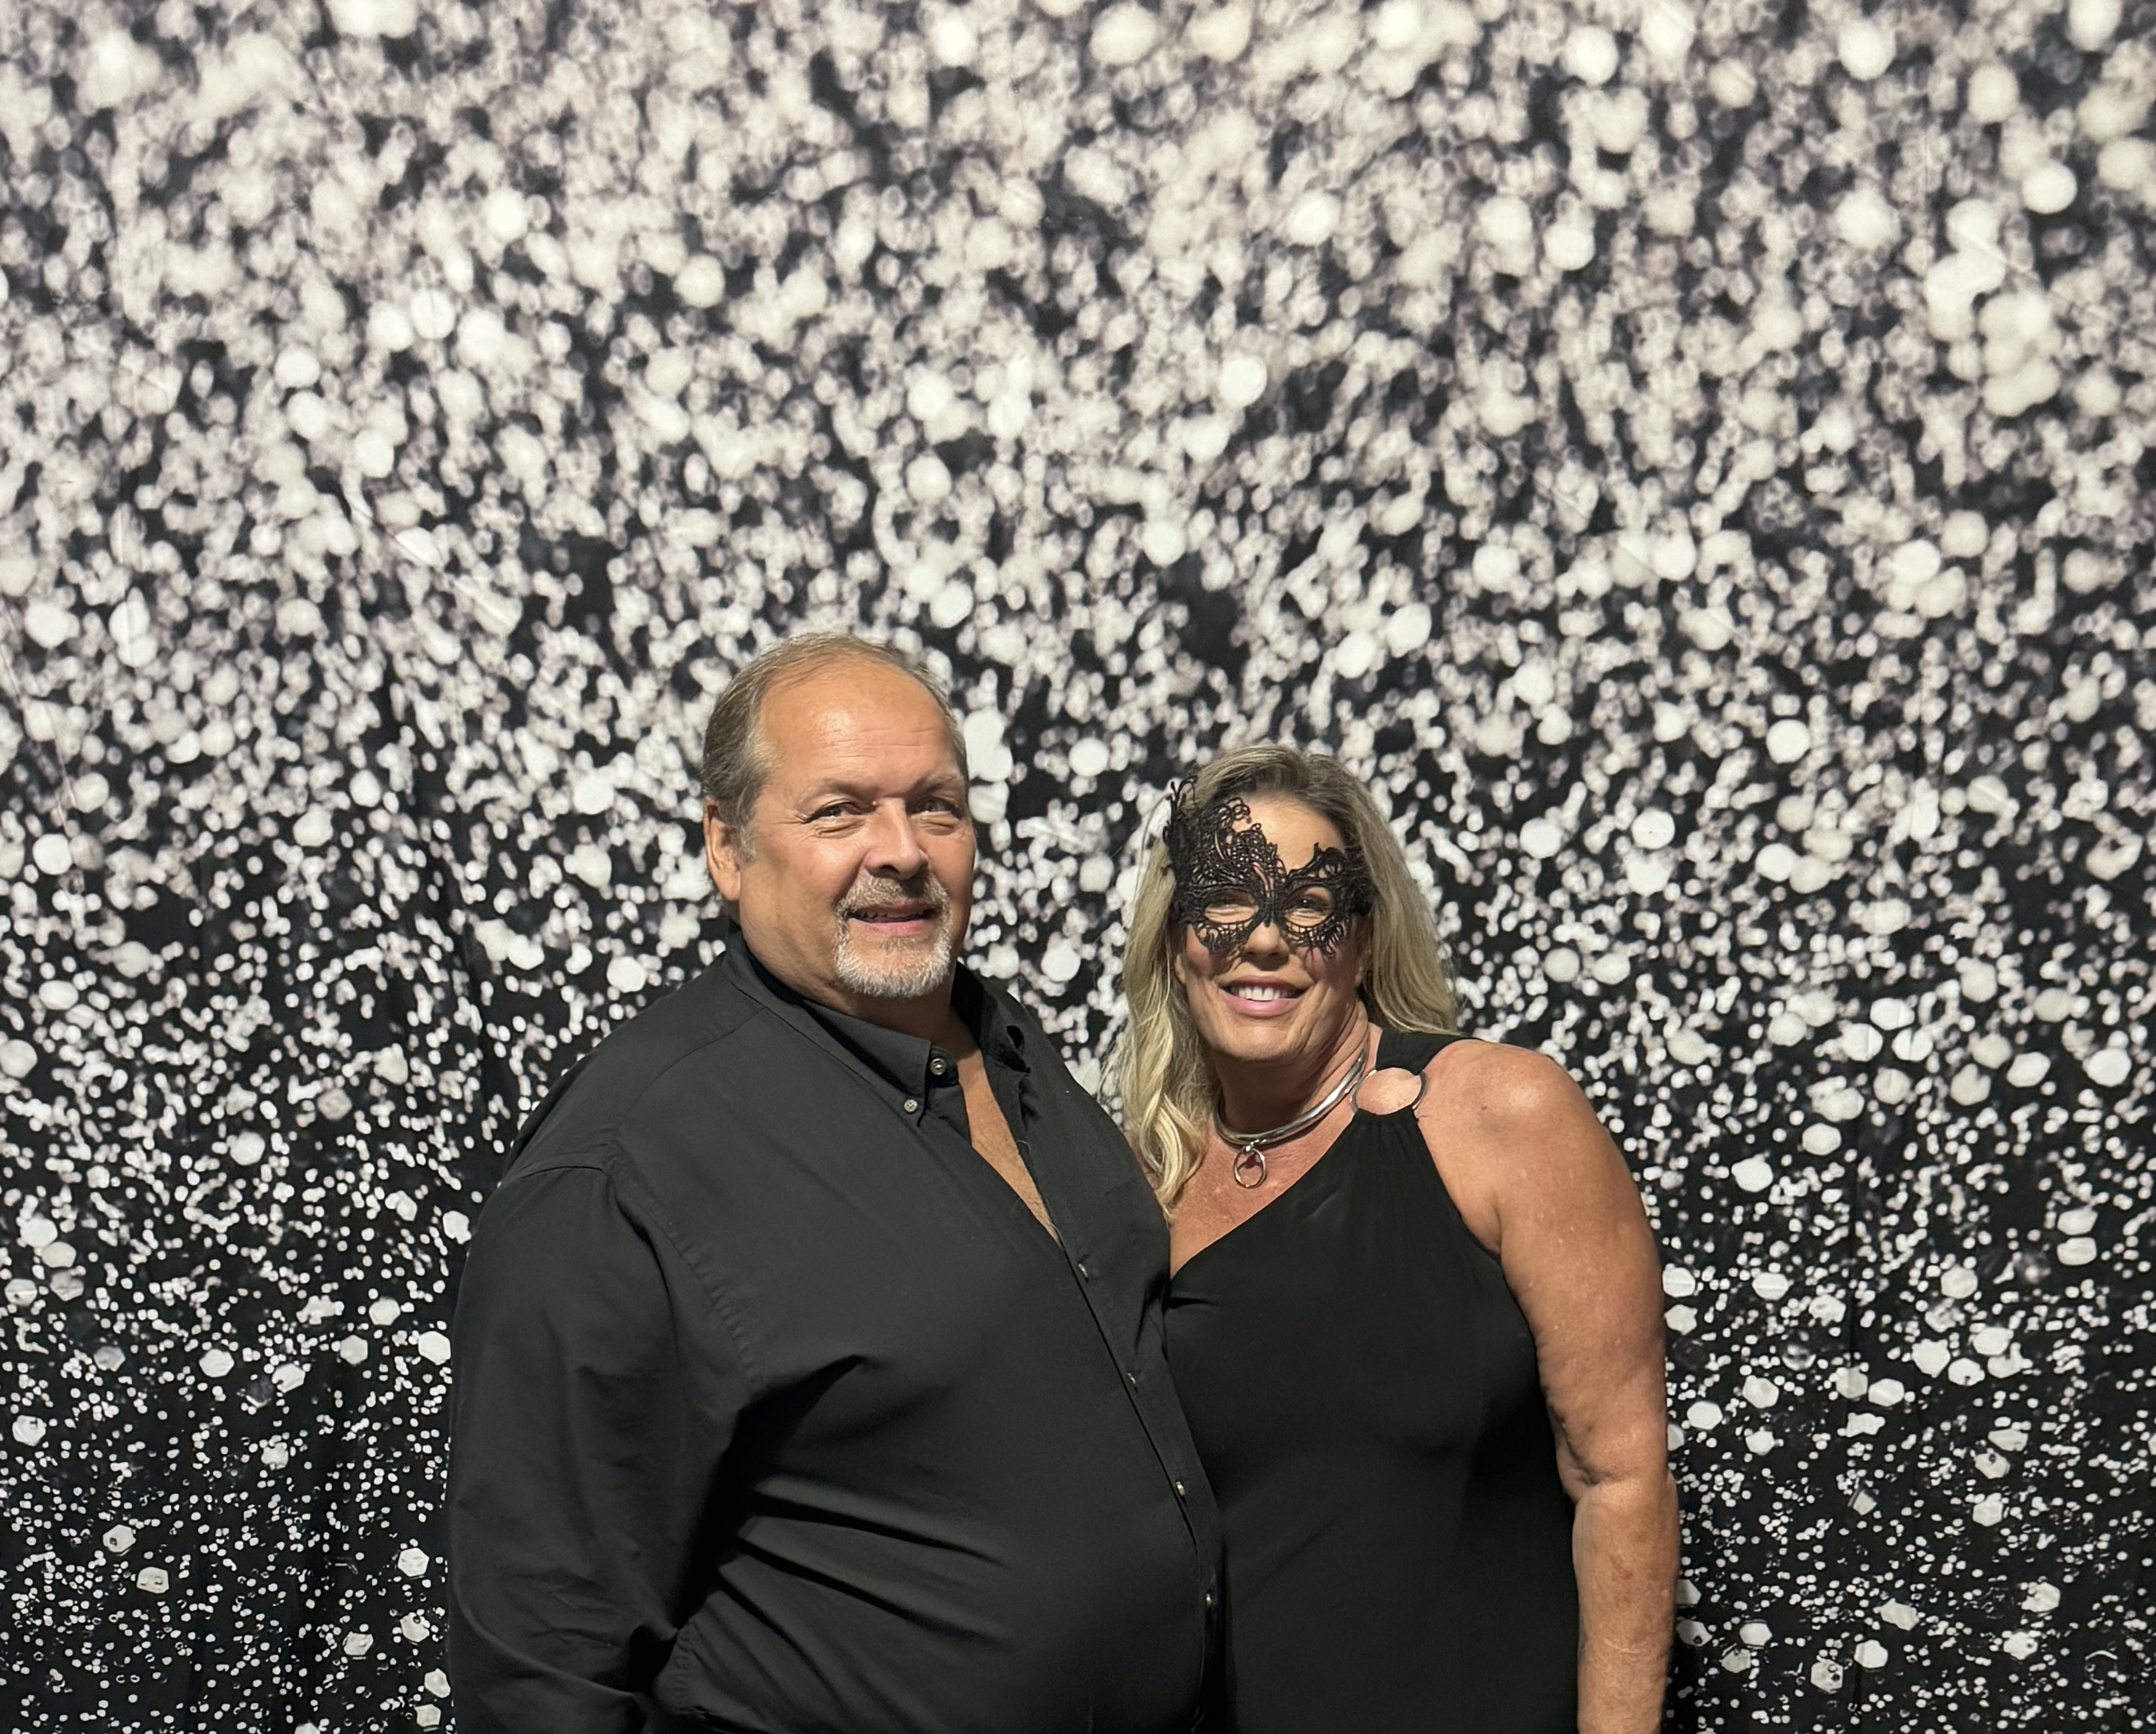
Welcome
To Xanadu KINK
Where Experience and Education is honored, and every year is a kinky one. Contact US
About Bios House of Xanadu Power Exchange Podcast
Together

Slide 18
Xanadu Kink is a vibrant, welcoming hub for those living, learning, and thriving within power exchange and kink dynamics—at every stage of life. As the proud home of House of Xanadu, Power Exchange Together (PET), and the podcast Kink Doesn’t Retire, we’re rooted in tradition, driven by curiosity, and fueled by connection.
At our core, we believe kink is more than a bedroom activity—it’s a lifestyle, a relationship philosophy, and a powerful path to authenticity. Whether you're just beginning your journey or decades deep in your dynamic, Xanadu Kink offers a space to grow, serve, lead, and explore with purpose.
Xanadu Kink Family
House of Xanadu embodies High Protocol, ritual, and education within a structured household dynamic.
Power Exchange Together (PET) is a community initiative offering support, discussion, and workshops for those curious about or committed to power exchange relationships.
Kink Doesn’t Retire—our lifestyle-focused podcast—celebrates the depth, humor, and real-life stories of mature kinksters living their truth, their way.

Slide 19
Knight_of_Xanadu
TheGirl_Star
For over 22 years, I’ve shared my life with my beloved wife and submissive, TheGirl_Star. From the very beginning, our marriage has been rooted in Kink and power exchange—long before we ever stepped into the larger kink community.
Through the House of Xanadu, I offer friendship and mentorship, providing structured guidance to those seeking deeper, more intentional power exchange. I am committed to cultivating a space where individuals and dynamics can learn, grow, and explore this lifestyle with safety, wisdom, and mutual support.
I lead with honor, and believe in building legacies—one protocol, one ritual, one meaningful connection at a time.
Hi there! I'm TheGirl_Star
A passionate educator, and devoted submissive. I have spent years as a special education teacher, and brought that same love of structure, patience, and teaching into everything I do now.
Alongside my Daddy and husband of 22 years, I’ve immersed myself in the study and practice of High Protocol. We’ve attended countless classes, intensives, and events.
I love teaching others, especially when it comes to blending tradition with fun. I do it with heart, intention, and a whole lot of glitter. 💖✨
All
About
US

Slide 20
Reviews
Houseof RA is feeling fabulous December 2, 2024 TheGirl Star and TheDaddy Chuck First Annual High Protocol Formal Dinner for The Illuminati House Of Ra was huge success! #IHOR would like to thank both for their formal dinner on hand on training for both the servers and that guest. The total experience was done to perfection!
Octavia Autum March 2025 I admire your love for etiquette, desire to teach, the planning, creativity, and hospitality. Just all the things about you. Thank you for one of the most wonderful experience of my life!
Harley April 2025 It was an honor to have the opportunity to be a part of the learning and demo dinner!
Amanda April 2025 You did amazing! It was such an honor to be a part of it! Thank you for allowing us to be a part of such an amazing experience! Look forward to another one.
See Our FetLifePage For More
Educating the Community
One Class
At A Time
Introduction to High Protocol Dining
Elegant and Timeless A Guest’s Role in Ritual and Service
How to Be a Kinky Princess Crowned in Kink
The Art of the Scene: How to Write a Scene Crafting the Moment
House
of
Xanadu
Creating Magical Moments
Through Elegance & Grace

Slide 21
Power Exchange
Together
North Central
New Jersey
Power Exchange Together (PET) North Central NJ is an organization that is committed to supporting participants that have a desire to explore power exchange relationships in a healthy, safe, consensual, and constructive way by exchanging ideas, knowledge and experience.
We understand that power exchange relationships differ based on the individuals within their own consensual dynamic.
.
So, join us each month as we welcome everyone into the world of power exchange
For more information on monthly in person meetings visit our FETLife page.
Must be vetted to attend

Slide 22

Hello, my lovely deviants and dignified deviants-to-be!
Welcome to the Kink Doesn’t Retire Podcast where age is just a number, and pleasure has no expiration date.
Whether you're rediscovering your desires, deepening your dynamic, or just starting to explore kink later in life, you’ve found your people
Share Your Story or Ask a Question
Want to be featured on the show? Have a question for Knight of Xanadu or TheGirl_Star or a story about kink later in life?
Submit it here - Google Form
anonymously or with your name. Let’s build this community together!
Podcast
Where Mature Minds meet Kinky fun

Slide 23
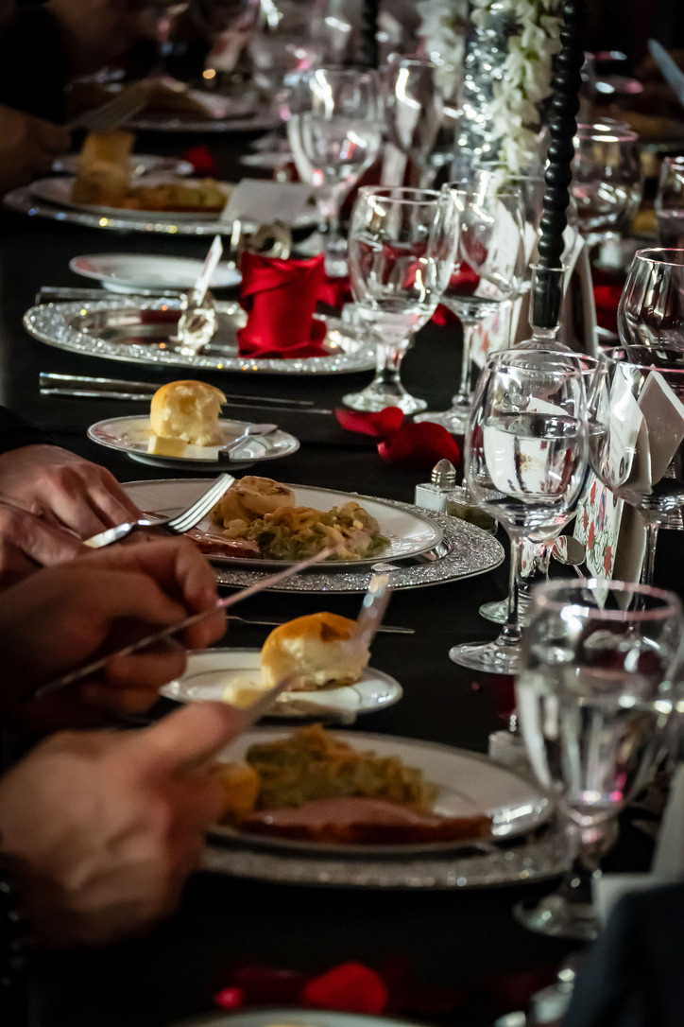
Contact Us
FETLIFE:
Xanadu Kink
House_of_ Xanadu
Power Exchange Together-PET North Central NJ
Knight_of_Xanadu
TheGirl_Star
For More Information:
Email: XanaduKink@gmail.com
Or
pet.north.central.nj@gmail.com

Slide 24
Contact Us
FETLIFE:
Xanadu Kink
House_of_ Xanadu
Power Exchange Together-PET North Central NJ
Knight_of_Xanadu
TheGirl_Star
For More Information:
Email: XanaduKink@gmail.com
Or
pet.north.central.nj@gmail.com

Slide 25
Links you need:
Page Podcast: Question form
https://forms.gle/pMu5evJYx1BDBMp86
Contact Page:

